Slide 1



YouTube Data Harvesting & Warehousing
Efficient Data Management and Analysis
By
M G Rajananthini

Slide 2
Introduction
Welcome to the YouTube Data Harvesting and Warehousing Project presentation. Today, we'll explore how we efficiently manage and analyze YouTube data to derive valuable insights.
Project Goals & Objectives: The problem statement is to create a Streamlit application that allows users to access and analyze data from multiple YouTube channels.
Importance of YouTube Data Analysis:
Marketing: Understand audience behavior and preferences to optimize marketing strategies.
Research: Extract valuable insights for academic studies, market research, and trend analysis.
Content Creation: Tailor content strategies based on audience engagement metrics, leading to more impactful and relevant creations.

Slide 3
Project Overview
Our project involves a systematic process of collecting, storing, and analyzing YouTube data to derive valuable insights. Let’s break into the details of our workflow.
Workflow Steps:
Data Collection:- We gather data from YouTube using its API, capturing information on videos, channels, and user interactions.
Storage Solution:- YouTube data is efficiently stored in MongoDB, providing flexibility and scalability to accommodate our needs.
Data Structuring:- PostgreSQL organizes the data for analysis, enabling easy querying and extraction of insights.
This workflow ensures a seamless process from data collection to analysis, empowering us to make informed decisions and drive success.

Slide 4
Workflow of the Project
YouTube
API
Channel Details
Playlist Details
Videos Details
Comments Details
MongoDB
The YouTube API is like a toolbox for developers. It gives them access to YouTube's data and features so they can create apps or websites that interact with YouTube.
With the YouTube API, by using a channel ID and an API key, you can get details about videos, playlists, and comments for a particular channel. This lets you find out about the channel, its playlists, each video, and comments left on those videos. Just include the channel ID and your API key in your requests. It's a handy way to learn a lot about a specific YouTube channel and what's on it.
SQL
We've utilized MongoDB as a storage solution for the data we collected from specific YouTube channels using the API Key. MongoDB is a type of database known as a NoSQL database, which means it's designed to handle unstructured or semi-structured data, making it particularly well-suited for storing diverse types of data like what we obtain from YouTube.
We gathered data and put it in MongoDB. Now, we're organizing it into tables in a SQL database. Each type of data—videos, comments—gets its table. This makes finding specific info easier.
Once in SQL, we can fetch what we need with simple commands. For example, we can get all videos from a channel or all comments on a video.
This setup helps us manage data better, making it easier to work with and fetch information quickly.

Slide 5
Requirements
To begin this project, we need a few key components:
Python 3.x: Python is used for scripting tasks in the project. We recommend using Python 3.x for compatibility with the latest libraries and features.
MongoDB: MongoDB serves as our primary data storage solution. It's a NoSQL database that offers flexibility and scalability, making it ideal for storing unstructured data collected from YouTube.
PostgreSQL: PostgreSQL is utilized for structuring and organizing the data collected from YouTube. Its relational database model allows for efficient querying and analysis of structured data.
Google Cloud Platform (GCP) Account with YouTube Data API enabled: Access to the YouTube Data API is essential for retrieving data from YouTube channels. To access the API, you'll need a GCP account with the YouTube Data API enabled.
By having these components in place, we can effectively collect, store, and analyze YouTube data for our project. Make sure to configure each component according to the project's requirements and compatibility needs.

Slide 6
Step by Step Process
Installation: Install required Python packages using pip: streamlit, pymongo, psycopg2, pandas, and python-dotenv.
Declaration of API Key: Obtain API key from Google Cloud Platform and declare it in the code for authentication.
Collecting Data from YouTube: Write functions to retrieve channel, video, comment, and playlist data using the YouTube API.
Storing Data in MongoDB: Store collected data in MongoDB for efficient storage and retrieval.
Creating SQL Tables: Design and create SQL tables in PostgreSQL to organize and structure the data.
Displaying the Tables: Use Streamlit to create an interactive web interface for visualizing and exploring the SQL tables.
Streamlit Code: Develop a user-friendly Streamlit application for data input, storage, migration to SQL, and visualization.

Slide 7
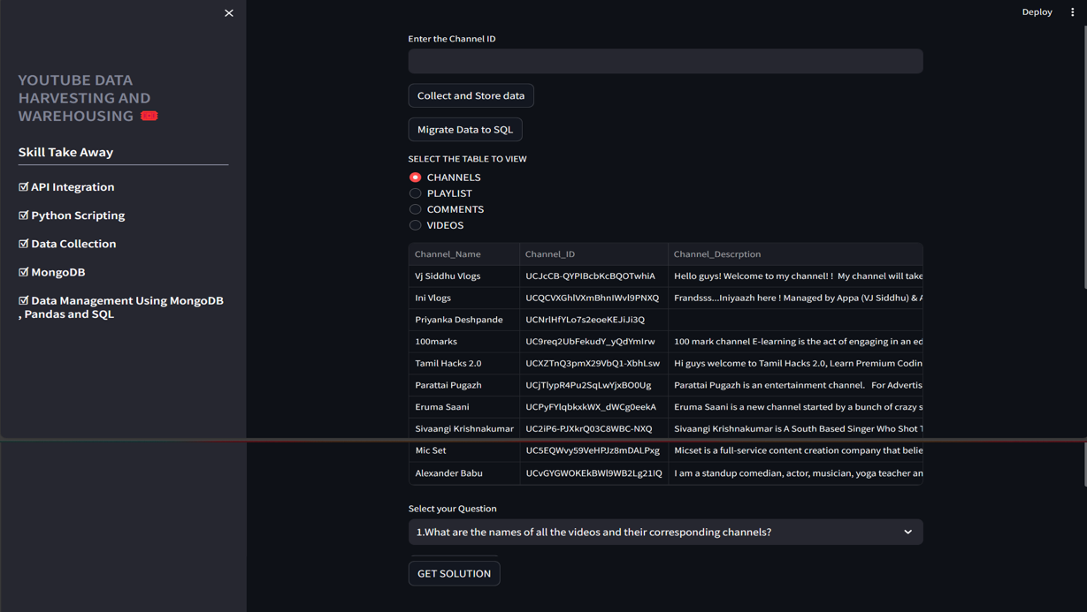
The Final Result of Our Project

Slide 8
Conclusion
Our YouTube Data Harvesting and Warehousing Project makes managing, finding, and studying YouTube data easier. Throughout this presentation, we've talked about the main steps we took to collect, store, and show YouTube data.
In short:
We've explained how we installed the tools we needed, stored data in databases, and created an easy-to-use interface.
Using MongoDB and PostgreSQL helps us keep our data organized and accessible.
With Streamlit, anyone can explore and understand the data we've collected.
Thanks for being part of our presentation! We're excited to keep improving our project and finding new ways to use YouTube data effectively.

